Slide 1



Ignitus PowerBI
View in Power BI
Last data refresh:
5/17/2023 9:53:11 AM UTC
Downloaded at:
5/17/2023 9:58:43 AM UTC

Slide 2
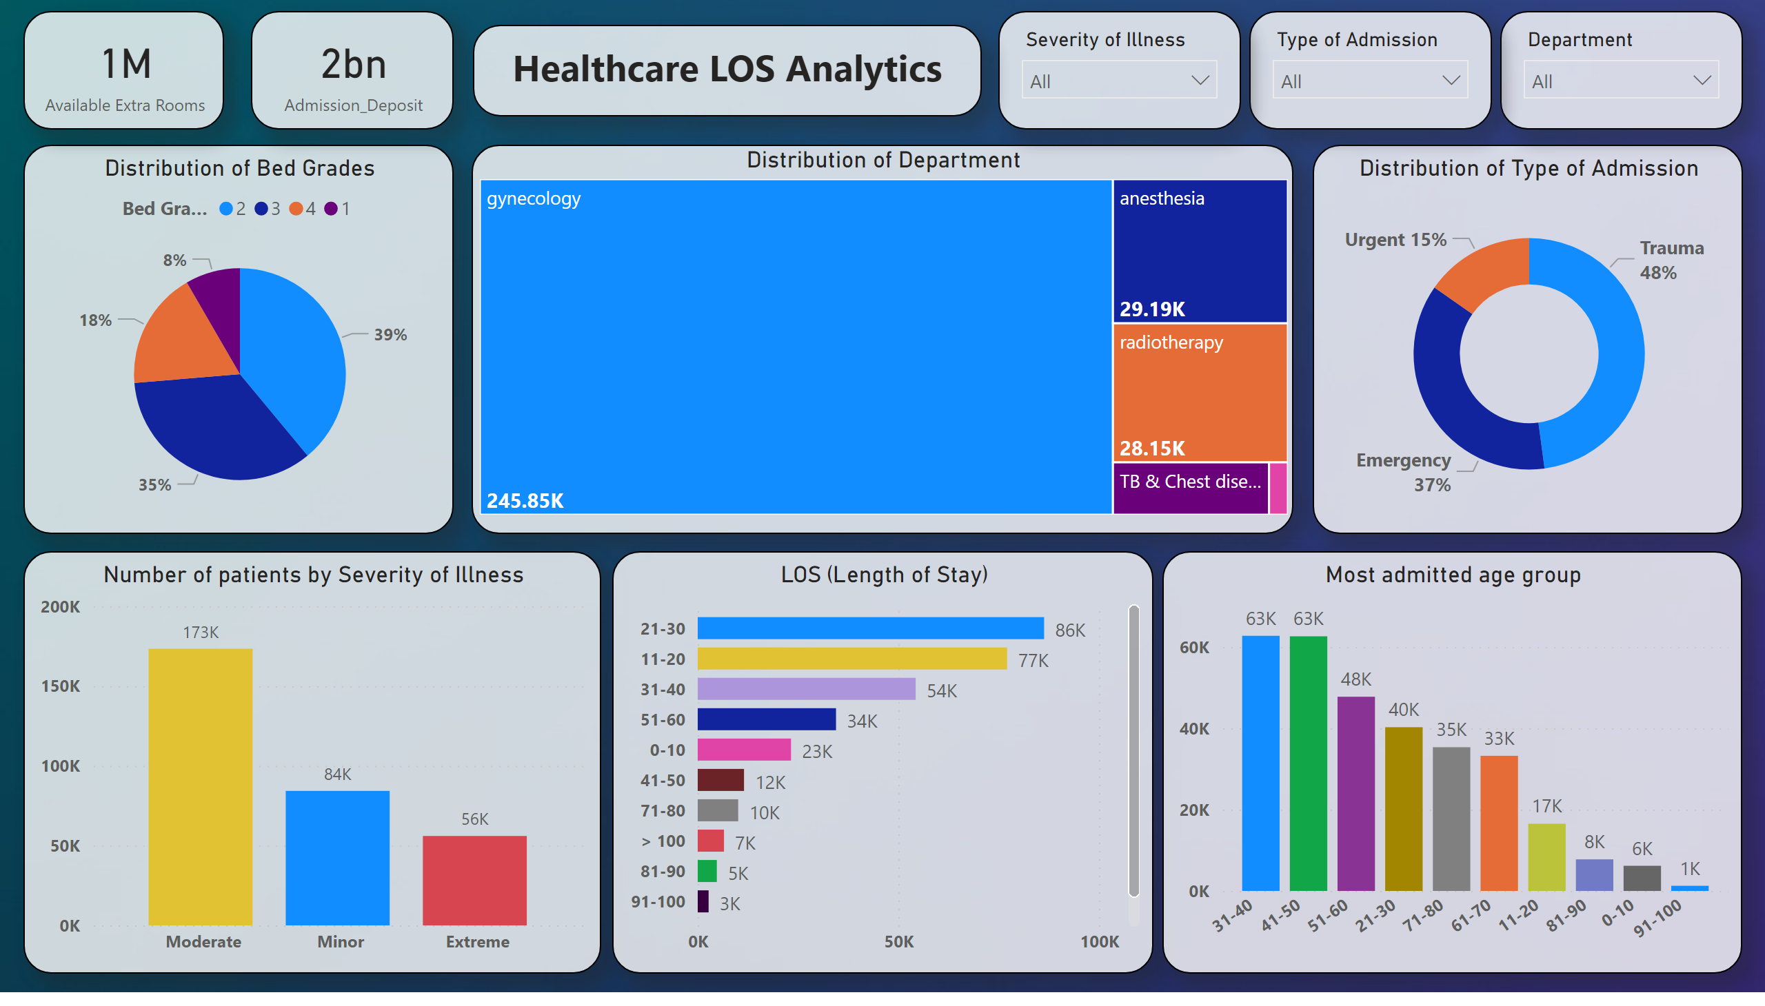
Page 1
Notes:
Distribution of Bed Grades
No alt text provided
Distribution of Department
No alt text provided
Number of patients by Severity of Illness
No alt text provided
LOS (Length of Stay)
No alt text provided
Distribution of Type of Admission
No alt text provided
Most admitted age group
No alt text provided
card
No alt text provided
card
No alt text provided
slicer
No alt text provided
slicer
No alt text provided
slicer
No alt text provided
textbox
No alt text provided

